Slide 1
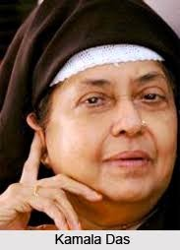
My Mother at Sixty-six
By Kamla Das

Slide 2
About the Poet
Kamala Das (1934-2009) was born in Malabar, Kerala. She is recognised as one of the foremost poets of India. Her works are known for their originality, versatility and indigenous flavour of the soil. She has published many novels and short stories. She wrote under the pen name “Madhavi Kutty”.
Her subject – matter is basically related to her personality, sensitivity, and anguish. External factors do not reflect in her writings. Her writings bring out her true inner feelings.
In the poem ‘My mother at sixty six’, she talks about her mother. This poem is based on the relationship between mother and daughter and the she shares her feelings for her mother.

Slide 3
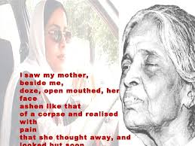
My Mother at Sixty-Six - Poem
Driving from my parent’s
home to Cochin last Friday
morning, I saw my mother,
beside me,
doze, open mouthed, her face
ashen like that
of a corpse and realized with pain
that she was as old as she
looked but soon

Slide 4
put that thought away, and
looked out at Young
Trees sprinting, the merry children spilling
out of their homes, but after the airport’s
security check, standing a few yards
away, I looked again at her, wan, pale
as a late winter’s moon and felt that old
familiar ache, my childhood’s fear,
but all I said was, see you soon, Amma,
all I did was smile and smile and
smile......

Slide 5
Vocabulary
Doze: nap
Ashen: pale
Corpse: dead body
Spilling: let out
Wan: dim, weak
Pale: dull, colourless

Slide 6
Explanation
While driving to Cochin from her parent’s home, the poetess’ mother accompanied her in the car to see her off. She sat beside the poetess. At one moment when the poetess turned and looked at her mother, she noticed that her mother was dozing and her mouth was open. Her face had turned ashen i.e., it seemed as if it had lost the vitality of life and her face looked like that of a corpse (dead body). The poetess was frightened as the reality seized her that her mother had grown old. She was not ready to accept it as old age is followed by death. So she tried to put the thought away.

Slide 7
She started looking out in order to take away the frightening thought from her mind. She noticed the trees sprinting in contrast to to her mother who looked lifeless while sitting beside her. She also noticed children coming out of their home happily. The happy children are representative of youth and power. Probably they were reminding her of the time when the poetess was a child and her mother was young.
Then they reached the airport. After the security check at the airport, she again looked at her mother who was standing a few yards away. She again felt that old familiar ache of losing her mother who looked like a late winter’s moon which loses its beauty in the fog. She felt that her mother had also lost her youth, vitality and had become inactive. She had a childhood fear of permanent separation from her mother. But she did not show it to her mother. She kept on smiling and smiling and said ‘see you soon, Amma. These were the words of reassurance that they would meet again and she smiled in an attempt to hid her feelings.
The lesson brings forth the emotions that a daughter harbours when she thinks about losing her mother.

Slide 8
Thank You…..

